Slide 1
CRM Application for Schools/Colleges

Slide 2
1. INTRODUCTION
1.1 : OVERVIEW
CRM (Customer Relationship Management) applications for schools/colleges are software systems designed to help educational institutions and manage relationships with their students, parents, alumni, and other stakeholders. These applications allow schools to collect and analyze data about these groups to improve engagement and communication.

Slide 3
1.2 : PURPOSE
Customer Relationship Management (CRM) applications for schools/colleges serve the purpose of managing relationships and interactions with students, parents, alumni, and other stakeholders. These applications provide a comprehensive system for schools/colleges to manage and track interactions with their constituents and ensure that they are meeting their needs.

Slide 4
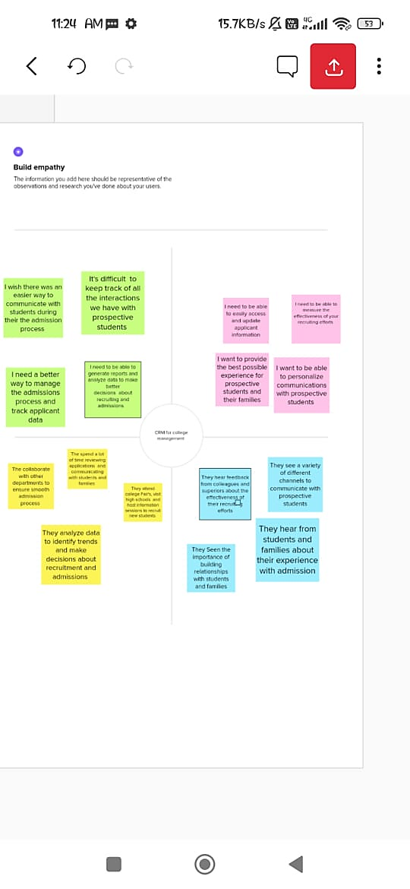
2. PROBLEM DEFINITION AND DESIGN THINKING
2.1 EMPATHY MAP

Slide 5
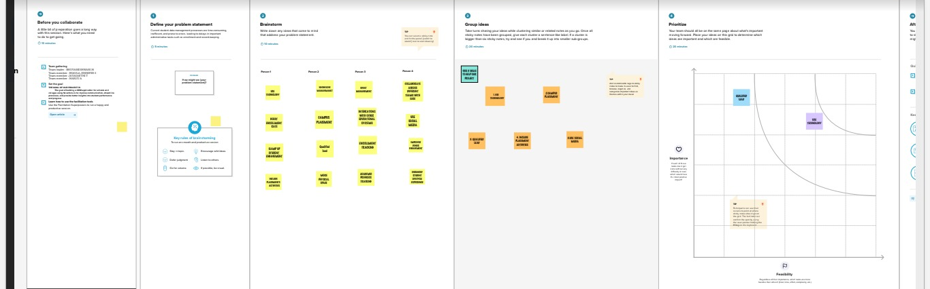
2.2 : BRAINSTORMING

Slide 6
3. RESULT 3.1: DATA MODEL
Object name | Fields of Object
College | Field Label | Data Type
 | Address | Text Area
 | District | Text Area
 | State | Text Area
 | Phone Number | Phone
 | Number of Students | Roll-Up Summary
 | Highest Marks | Roll-Up Summary

Slide 7
3.1: DATA MODEL
Object name | Fields of Object
Student | Field Label | Data Type
 | Phone Number | Phone
 | College | Master-Detail Relationship
 | Results | Pick List
 | Class | Number
 | Marks | Number

Slide 8
3.1: DATA MODEL
Object name | Fields of Object
Parents | Field Label | Data Type
 | Parent Address | Text Area
 | Parent Phone Number | Phone

Slide 9
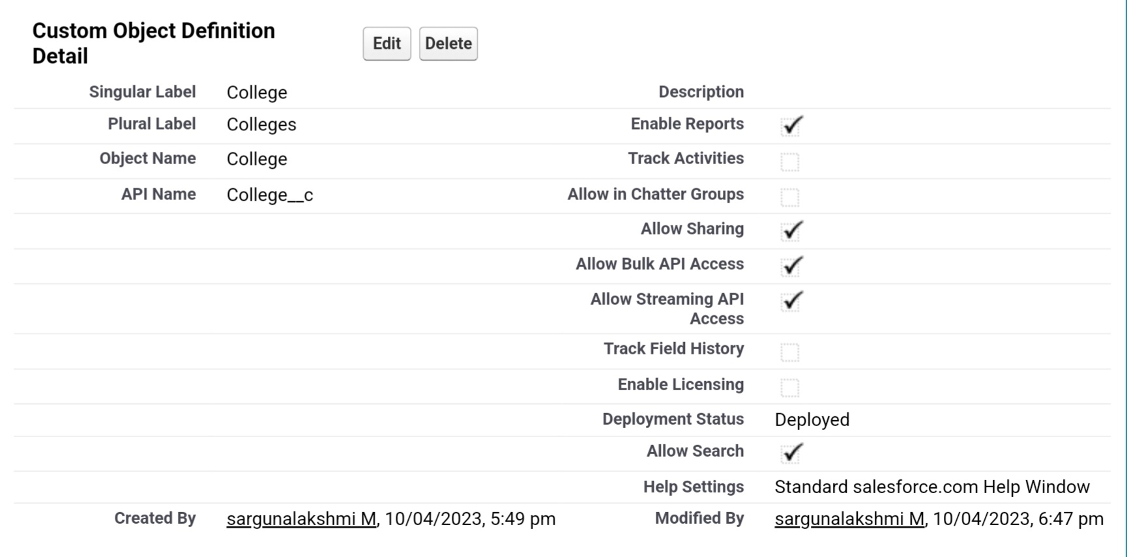
3.2: Activity & Screenshot ACTIVITY 1-OBJECT CREATION College:

Slide 10
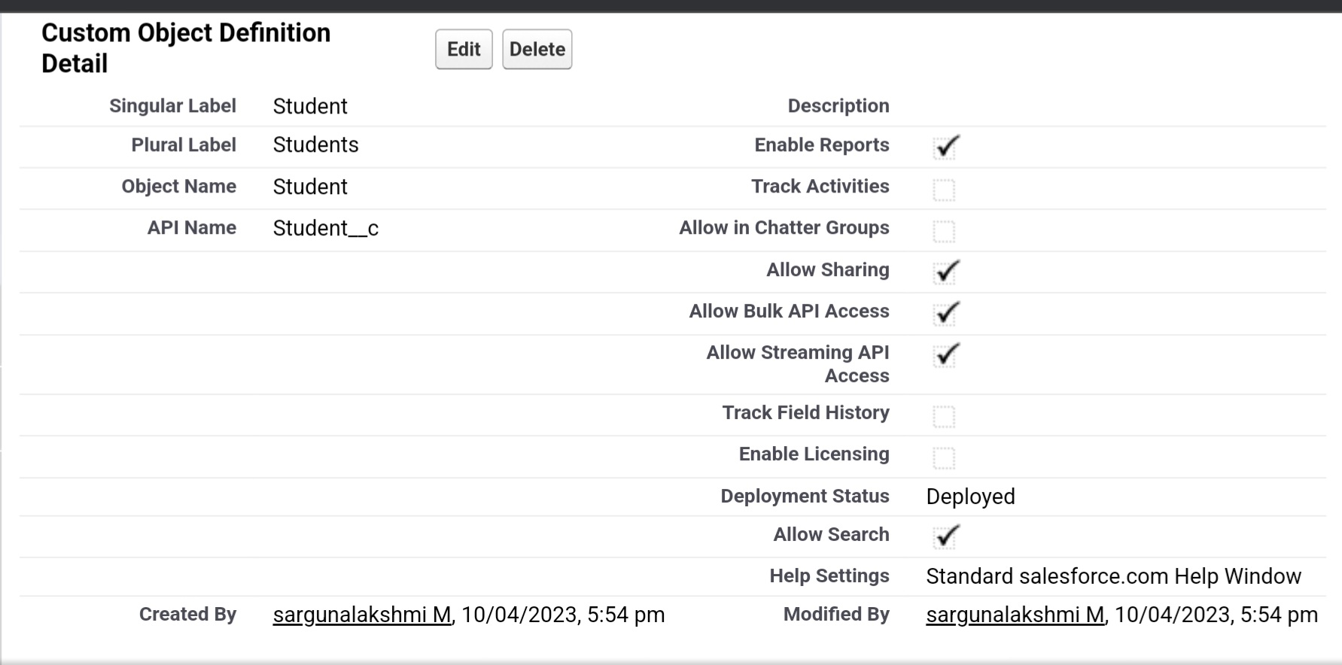
STUDENT:

Slide 11
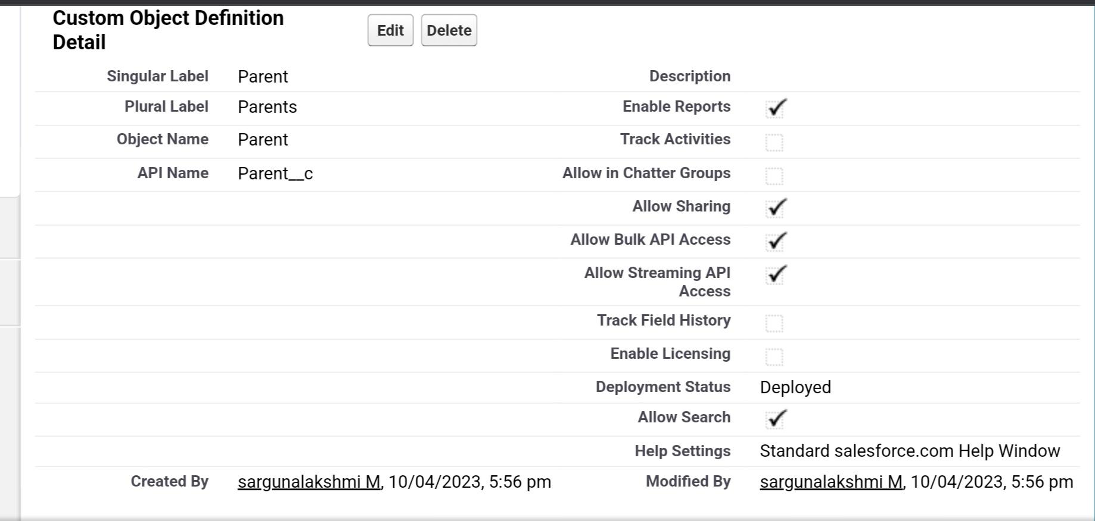
PARENT:

Slide 12
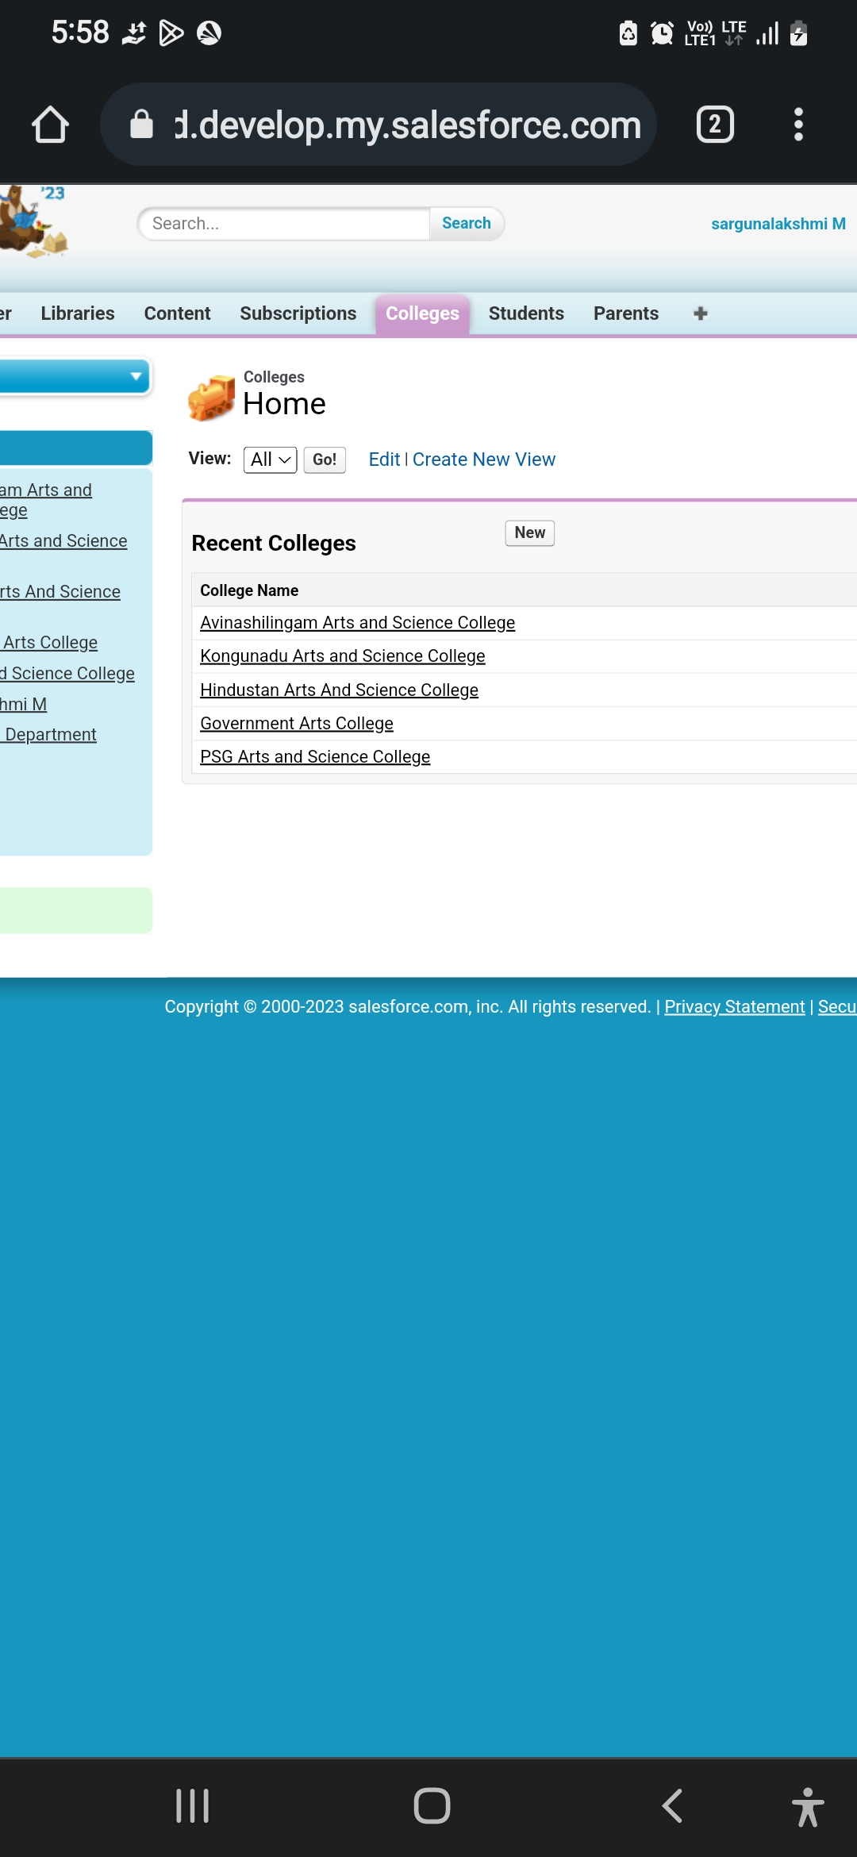
ACTIVITY 2: LIGHTING APP:

Slide 13
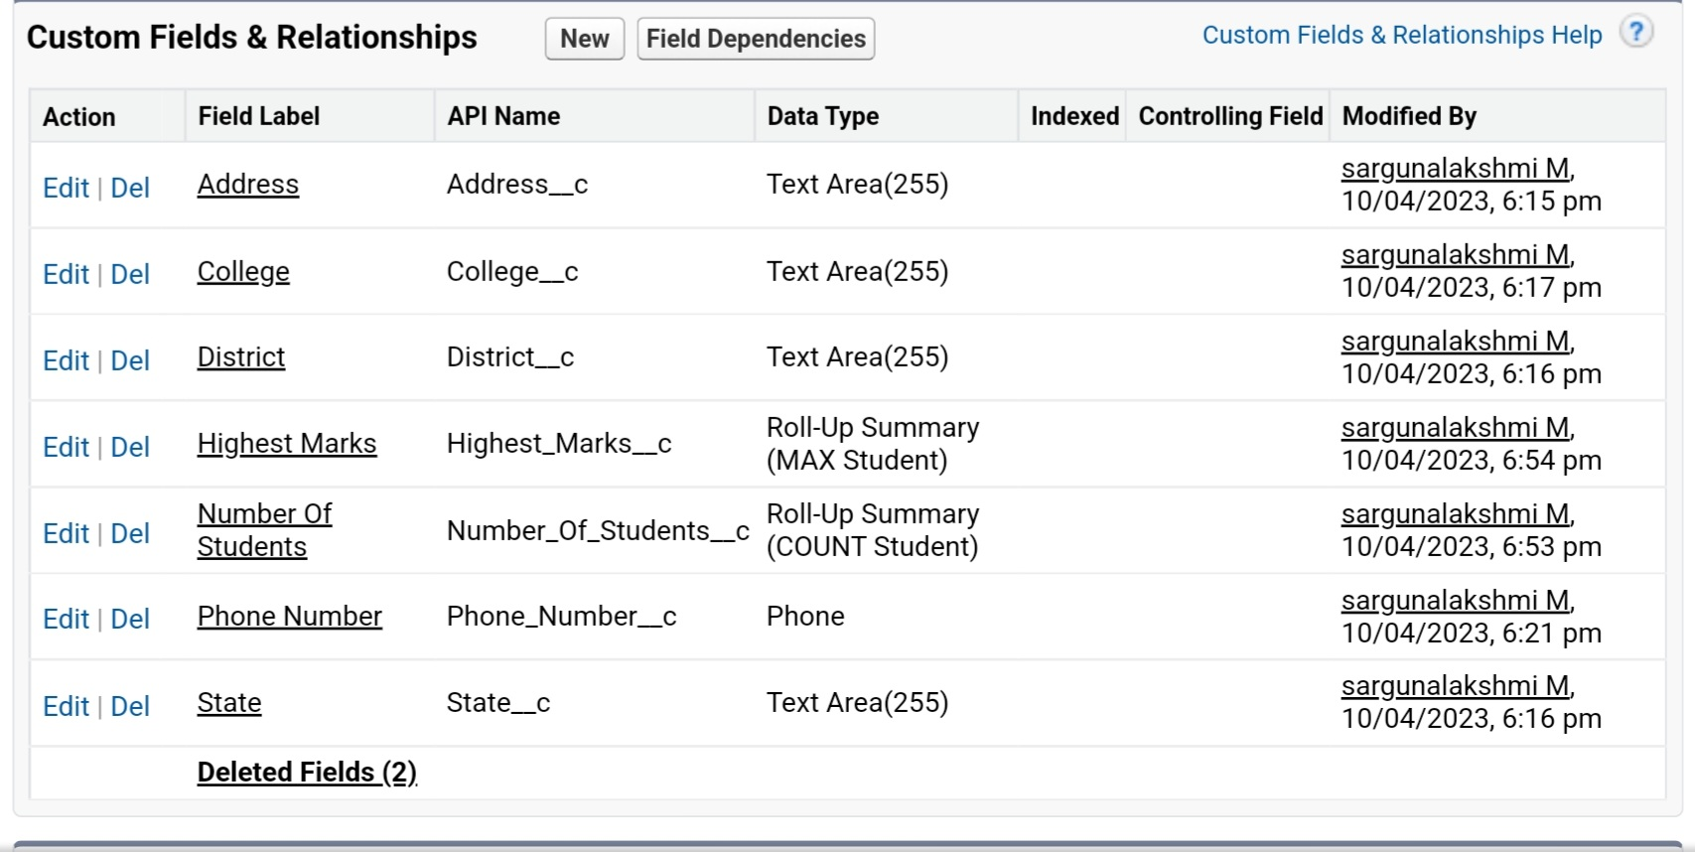
ACTIVITY 3: FIELDS AND RELATIONSHIP FOR COLLEGE OBJECT:

Slide 14
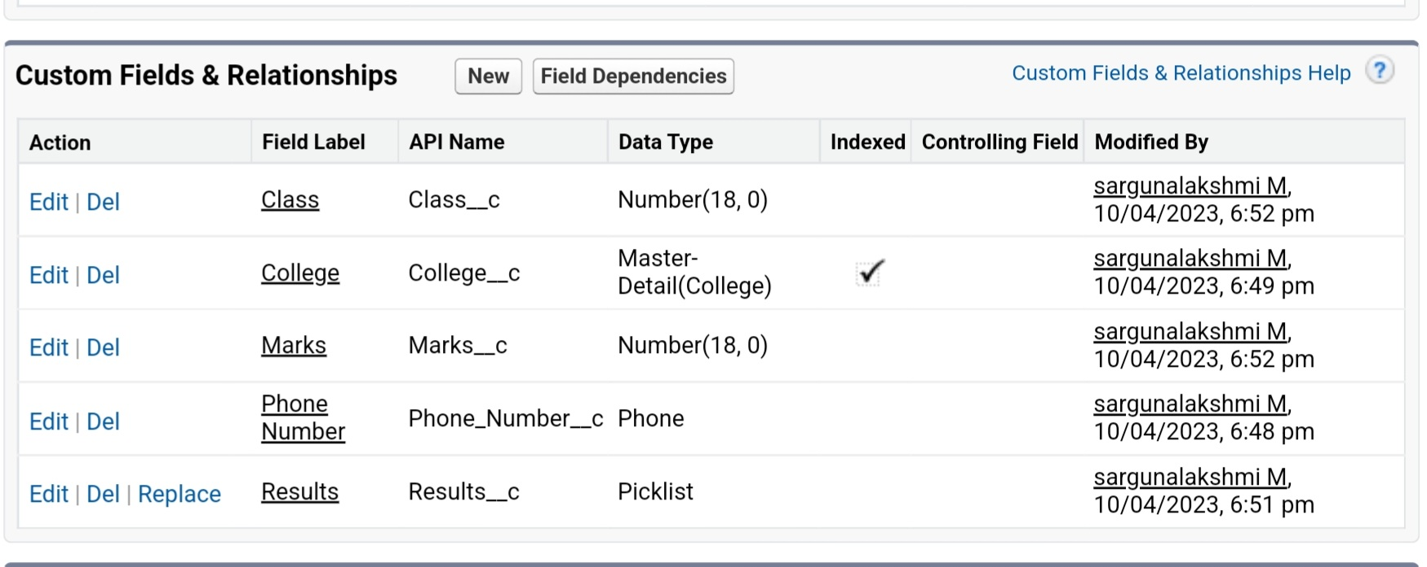
FIELDS AND RELATIONSHIPS FOR STUDENT OBJECT:

Slide 15
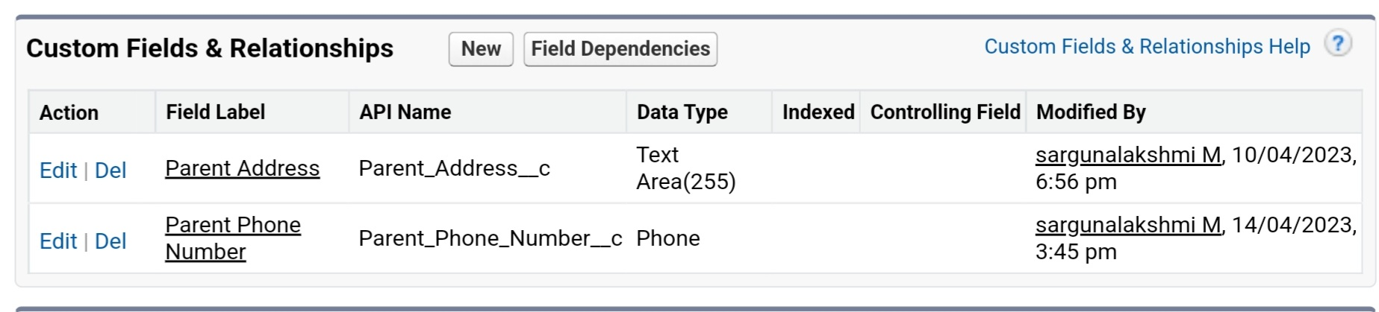
FIELDS AND RELATIONSHIP FOR PARENT OBJECT

Slide 16
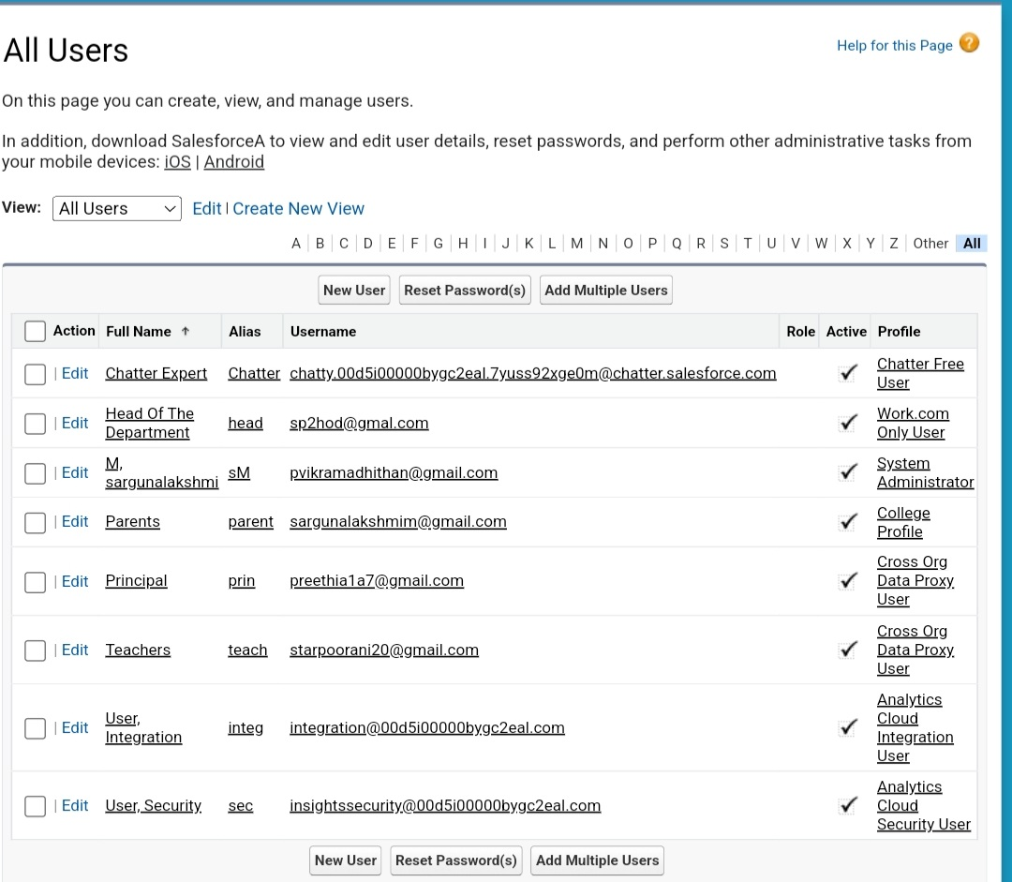
ACTIVITY 4: USER:

Slide 17
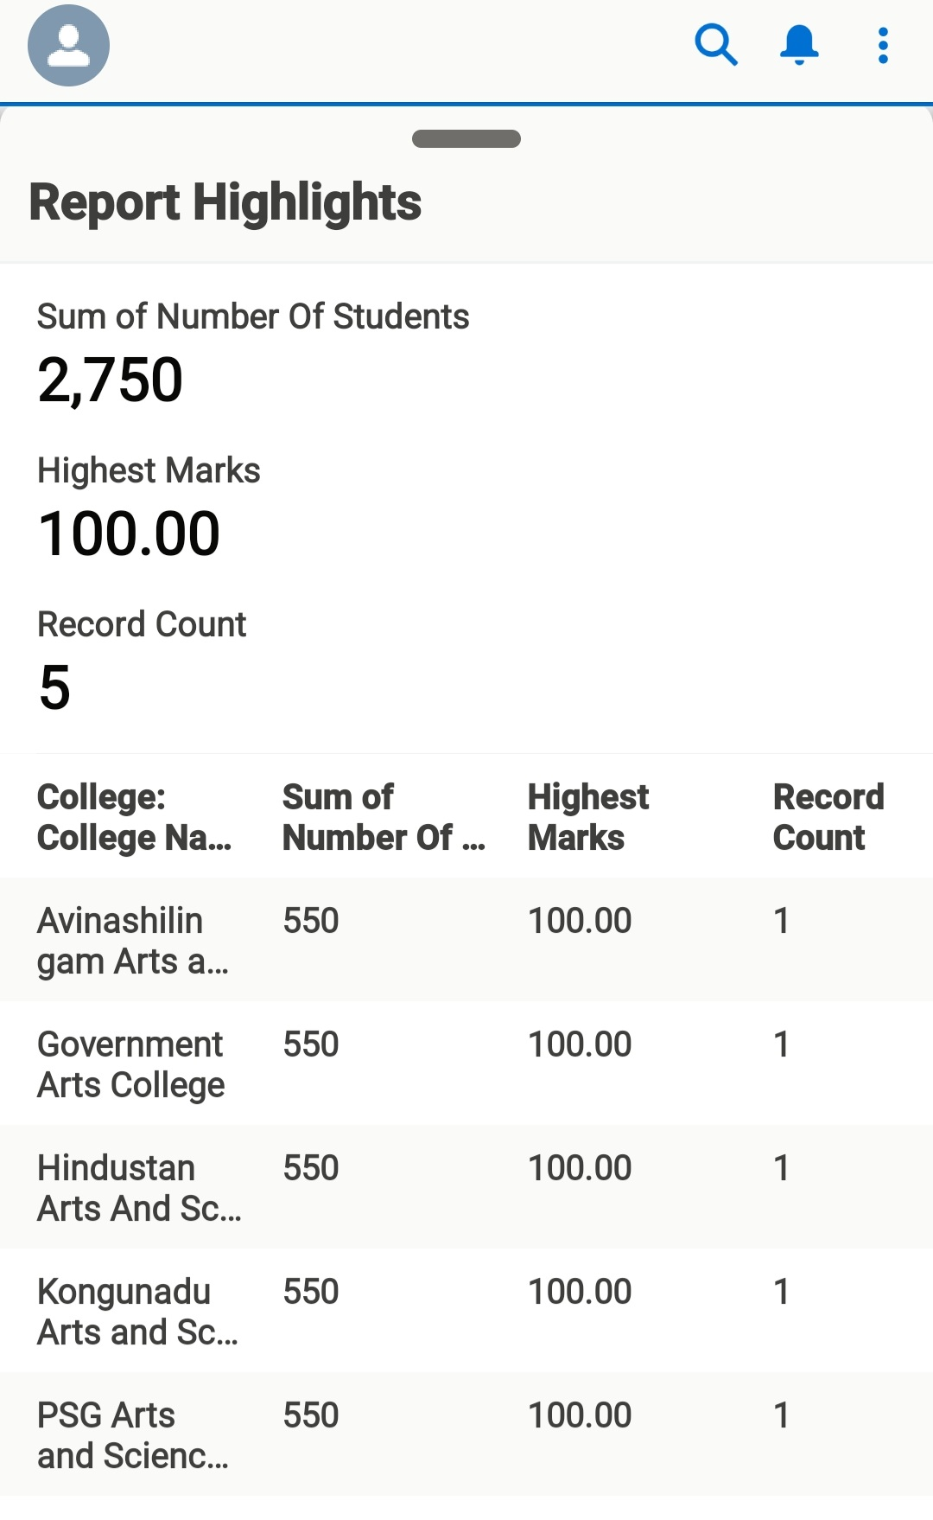
ACTIVITY 5: REPORTS:

Slide 18
4. Trailhead Profile Public URL
Sargunalakshmi (Team Lead)
https://trailblazer.me/id/sargm
Poorani
https://trailblazer.me/id/spooranis
Preethi
https://trailblazer.me/id/preethia

Slide 19
4. ADVANTAGES and DISADVANTAGES
4.1: Advantages
Improved efficiency: A CRM application for schools and colleges can help streamline the admissions process, automate workflows, and provide real-time data and insights, resulting in improved efficiency and reduced workload for admissions officers.
Personalization: With a centralized database of applicant information and integrated communication channels, admissions officers can provide a personalized experience for prospective students, enhancing their engagement and satisfaction.
Data-driven decision-making: Robust data analytics and reporting tools can provide insights into recruitment efforts and enable admissions officers to make data-driven decisions to optimize their strategies.
Collaboration: Collaborative tools and a centralized platform can facilitate communication and collaboration among admissions officers and other departments, resulting in improved coordination and teamwork.
Mobile accessibility: A mobile application can provide applicants and admissions officers with anytime, anywhere access to the CRM platform, improving accessibility and convenience.

Slide 20
4.2: Disadvantages
High cost: Implementing a CRM application can be expensive, especially for smaller schools or colleges, and ongoing maintenance costs can add up over time.
Resistance to change: Admissions officers and other staff members may be resistant to change, especially if they are accustomed to using traditional methods for recruitment and admissions.
Data security: A centralized database of applicant information must be secure and protected from cyber threats and breaches.

Slide 21
5. APPLICATIONS
Admissions and recruitment: A CRM application can be used to manage the entire admissions process, from initial inquiry to enrollment, including applicant tracking, communication management, and data analysis.
Student retention: A CRM application can be used to track student interactions and behavior, identify at-risk students, and implement targeted retention strategies.
Fundraising and development: A CRM application can be used to manage fundraising efforts and donor relationships, including tracking donations, sending personalized communications, and analyzing data to inform fundraising strategies.
Alumni relations: A CRM application can be used to manage alumni relations, including tracking alumni engagement, sending targeted communications, and organizing events.

Slide 22
6. CONCLUSION
CRM applications for schools and colleges are designed to help institutions manage their relationships with students, parents, and other stakeholders. These applications typically include features for managing student information, tracking enrollment and admissions, managing financial aid and scholarships, and communicating with students and parents. They may also include tools for tracking student performance, managing schedules and calendars, and providing analytics and reporting on student and institutional data. Some of the key benefits of CRM applications for schools and colleges include increased efficiency, improved communication, and better student outcomes.

Slide 23
7. FUTURE SCOPE
Customer Relationship Management (CRM) applications for schools and colleges have a promising future. With the increasing demand for personalized education, CRM applications can help educational institutions to manage relationships with their students, faculty, and other stakeholders effectively. These applications can assist in tracking student progress, managing communication with parents and alumni, and automating administrative tasks such as scheduling and recordkeeping. Moreover, with the integration of artificial intelligence and machine learning, CRM applications can provide valuable insights to improve student engagement and learning outcomes. As educational institutions continue to prioritize student success, CRM applications will play an essential role in enhancing the overall educational experience.

